Slide 1
Extreme Ultraviolet (EUV) Sources
Thanh Tung Le
$$R=k\frac{λ}{NA}$$
Notes:
EUV aims to improve resolution via lowering wavelength

Slide 2
Contents
Motivation
Overview
Technical issues
Power, resist sensitivity and shot noise
Masks
Materials and debris mitigation
EUV lightbulbs
Philips
Gigaphoton
Cymer
Conclusion

Slide 3
Motivation
Continuation of Moore’s Law
Current DUV (193nm) - ~40nm features
Reduction of wavelength to EUV (13.5nm) - ~10nm features
Wagner et al., Nature Photonics 4, 24-26 (2010)
Notes:
Next steps in reducing wavelength? Following historical trends?

Slide 4
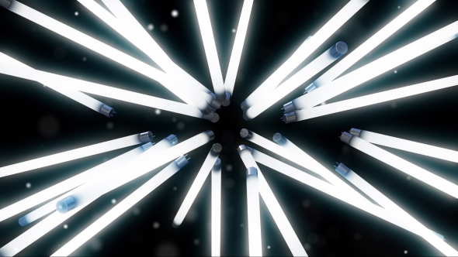
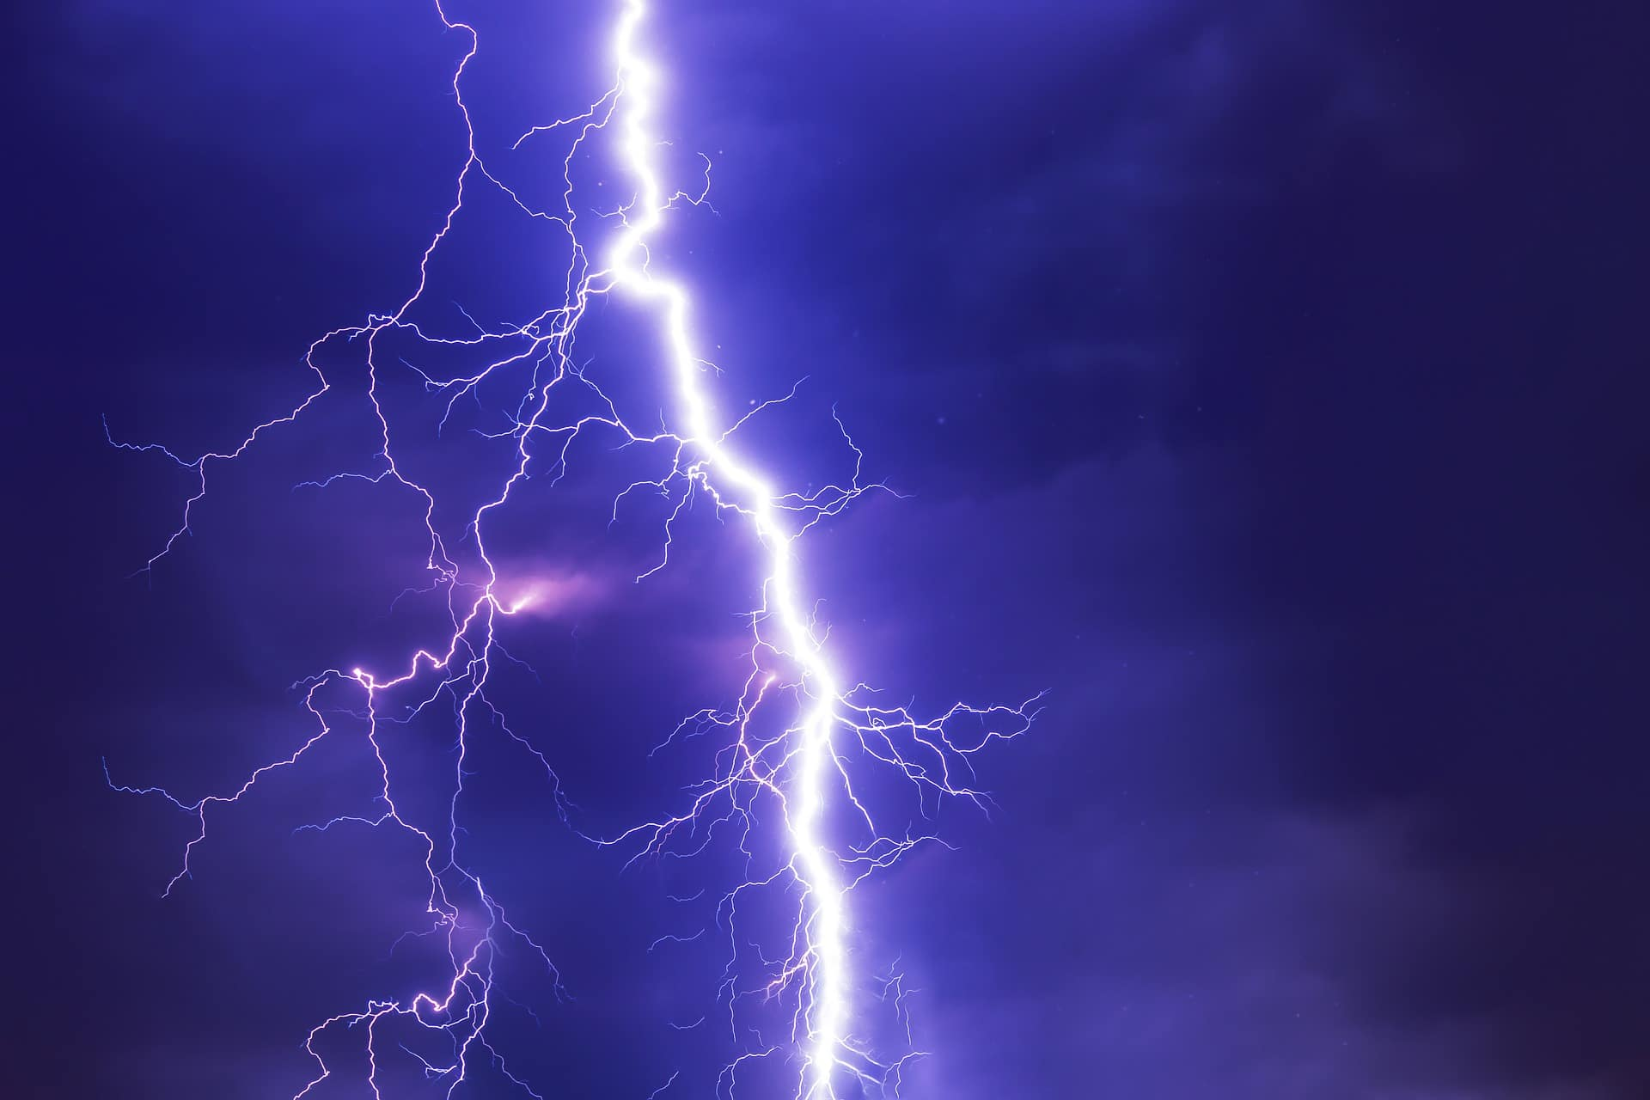
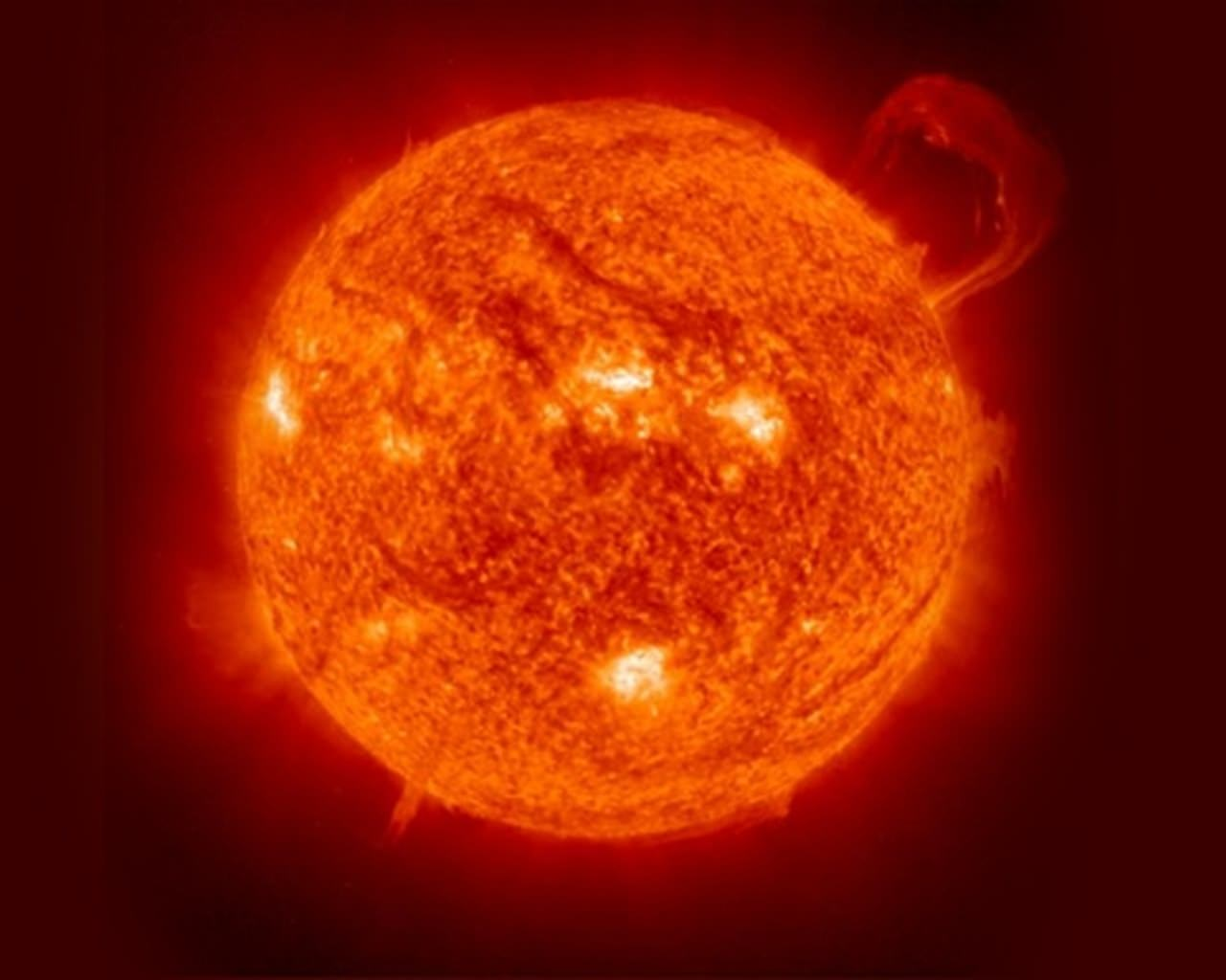
Plasma
Fourth fundamental state of matter
Ionization until conductive
Requires excitation of atoms
Emits light (photons) upon deexcitation
Notes:
Plasma commonly seen in nature
Neutral substance ionizes until becoming conductive
Needs external excitation
Excitation leads to deexcitation – photons emitted to give EUV

Slide 5
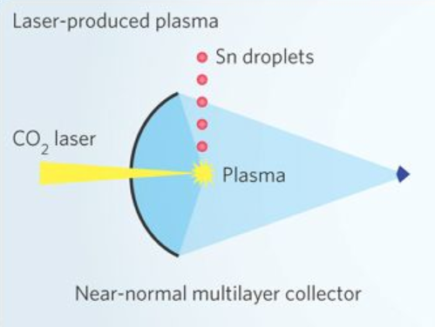
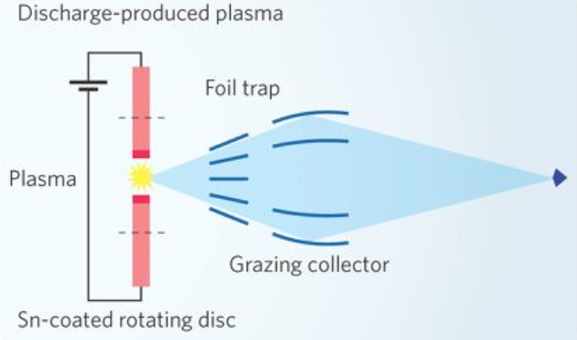
Plasma as EUV sources
Laser-produced
Discharge-produced
Wagner et al., Nature Photonics 4, 24-26 (2010)
Notes:
Two major methods to produce plasma and hence EUV
Laser-produced (excitation by high-energy laser => vaporizes, ionizes and generates plasma)
Discharge-produced (excitation by high voltage => discharge, vaporizes, ionizes and generates plasma)
Collector mirror to receive, reflect and focus emitted light at intermediate focus (IF)
Foil trap to mitigates effects of debris on collector

Slide 6
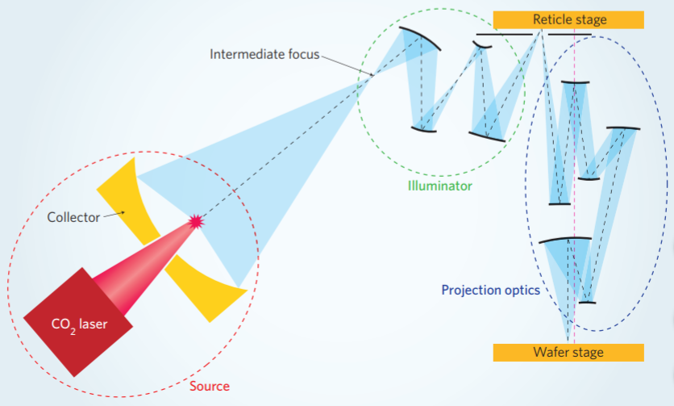
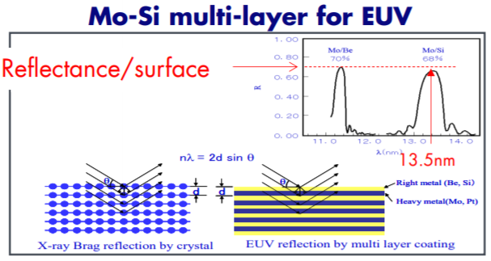
EUV light absorbed by all matter
Operation under vacuum
Use reflective optics
Multilayered mirrors (MLMs)
Only 70% of light reflected
Deposition of materials on mirrors
Reflective masks
H. Mizoguchi, 2017 EUV-FEL WS
Wagner et al., Nature Photonics 4, 24-26 (2010)
Notes:
EUV light absorbed by all matter
Uses vacuum system
Uses reflective optics, NOT refractive optics like DUV (193nm)
Uses multilayered mirrors (MLMs) consisting alternating layers of molybdenum (Mo) and silicon (Si)
Mirrors work by Bragg reflection and interlayer interference
13.5nm chosen as max reflectance at wavelength
Only 70% reflectance => many mirrors, only receive small part of light => power issues (very low)
Other issues include deposition of materials on mirrors and design of reflective masks

Slide 7
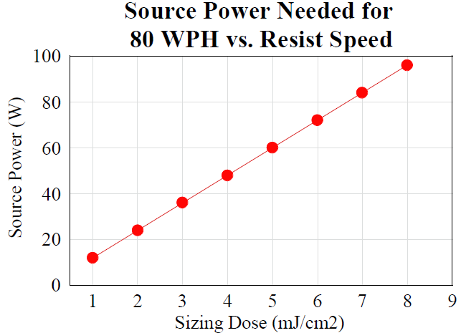
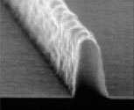
Issues with throughput
Arises from low power of source (10-20W currently)
More sensitive resists used
Line Edge Roughness (LER)
Gets worse
Shot noise
Cobb et al., Mat. Res. Soc. Symp. Proc. Vol. 7 (2002)
T. Tomie, J. Micro/Nanolith. MEMS MOEMS 11(2) (2012)
Notes:
Low power of source as many mirrors used
Low throughput unless very sensitive (low mJ/cm2) resists used – see graph
Sensitive resists means only small amount of photons reach per unit area of resist => stochastic effects or shot noise
Poorly-defined edges of developed pattern => Poor line edge roughness (LER)

Slide 8
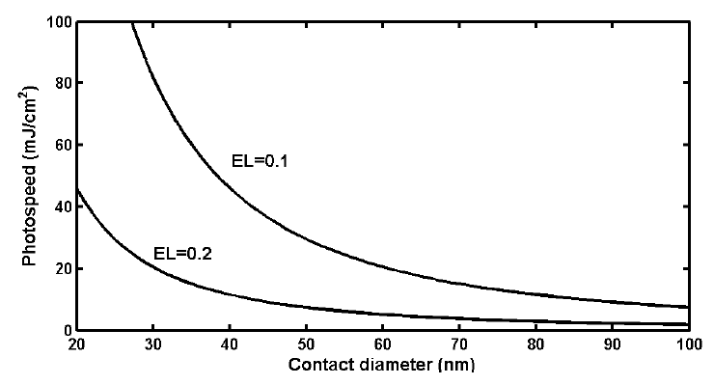
Shot noise imposes sensitivity requirements
Simulation (Lee et al.) to examine dose needed to print at acceptable yield (98%) of contact holes
Increasing exposure latitude (EL) or decreasing sensitivity
Lee et al., Proc. of SPIE Vol. 5037 (2003)
Notes:
Exposure latitude is range of dose delivered for successful printing of a contact. 0.2 corresponds to +/- 10%
Simulation using Poisson distribution to determine effects of shot noise on contact printing
If high yields (only graph 98%) and small size required, non-sensitive (‘slow’) resists need to be used to achieve both or increase EL

Slide 9
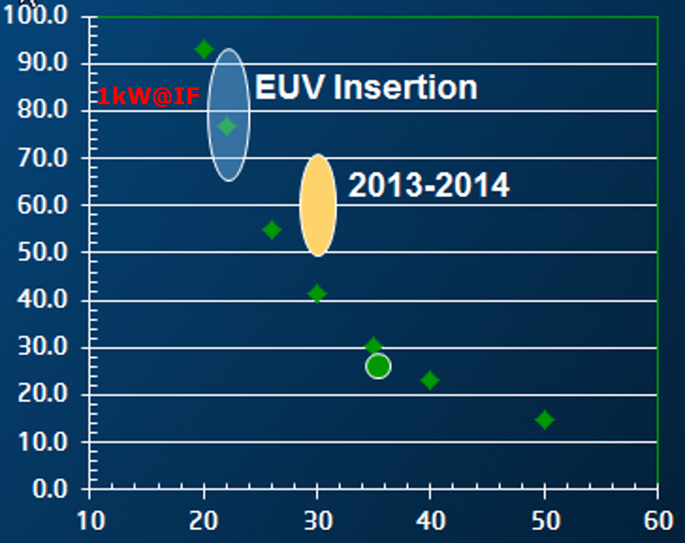
Sensitivity requirements imposes power requirements
Low sensitivity => longer exposure time => increases costs
Increase power for throughput
Dose-to-print vs. contact size
1kW at Intermediate Focus (IF)
4 times power under development
Y. Borodovsky, 2012 EUV Litho. WS
Notes:
1000W at Intermediate Focus
Simulation results from Lee et al. suggests high power needed to print features at acceptable yield and throughput
Power needed is much higher than those being currently developed by companies (250W on current roadmaps)
Need major innovations for high volume manufacturing (HVM)

Slide 10
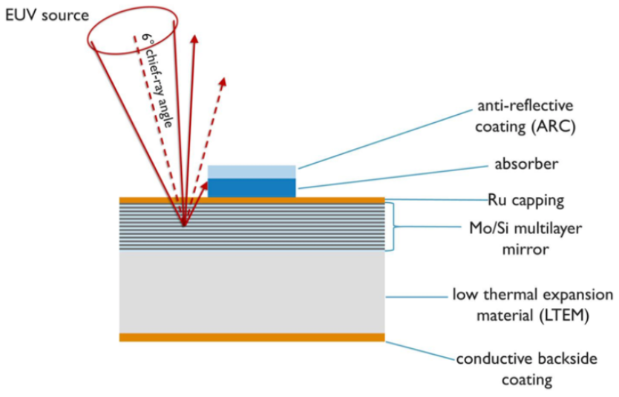
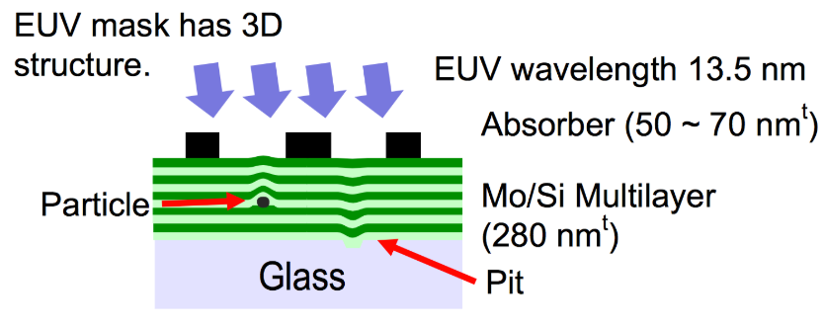
Masks and defect management
Employ reflection rather than transmission
Complex to produce – multilayers (NOT chromium on glass)
Prone to defects
3D effects
https://semiengineering.com/searching-for-euv-mask-defects/
https://semiengineering.com/next-euv-issue-mask-3d-effects/
Notes:
Power is not only issue
Making defect-free masks is also issue
EUV masks very complex, requires more layers than optical masks => easy for defects to occur
Also reflective => 3D effects from lights from different incident angles reflecting from identical point

Slide 11
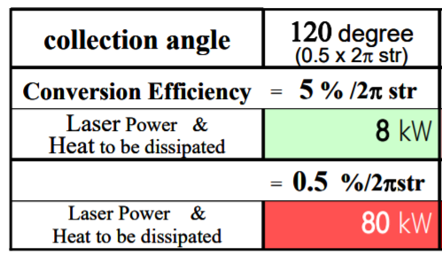
Materials and issues
Xe used initially (inert) – poor conversion efficiency (CE)
Dissipation as heat and cooling issues
Need new materials – Sn proposed
Debris is concern
Table: 100W at IF and power input requirements
T. Tomie, J. Micro/Nanolith. MEMS MOEMS 11(2) (2012)
Notes:
CE – output/input power (EUV power/laser power)
str – solid angle (3D version of angle, i.e. how much does light exposes on mirror)
Initial material used is xenon (Xe) as inert
CE is not good hence, if 100W at IF is needed, generates very high heat and requires very high input
Shifts to tin (Sn) as material used
Now need to concern with debris generated from Sn plasma

Slide 12
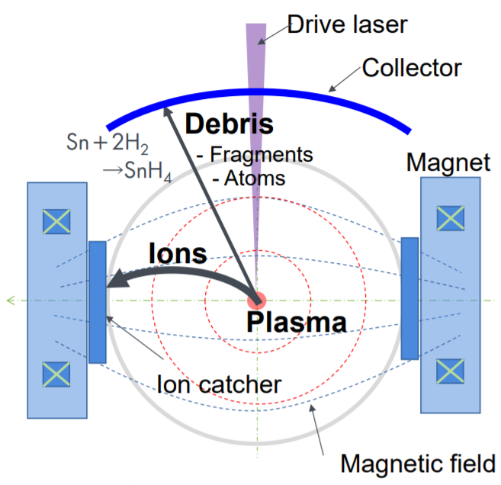
Debris mitigation
Plasma causes debris to accumulate on collector mirror
Need to prevent and remove for long lifetime
In situ cleaning
Magnet field for low-energy fragments
Hydrogen for chemical etching of
high-energy fragments
H. Mizoguchi, 2017 EUV-FEL WS
Notes:
Debris (fragments from Sn plasma) can damage collector mirror, reduces reflectivity and lifetime
Employs both physical and chemical means to mitigate debris
Magnetic field to force ions away from collector mirror
H2 inputs to react with high-energy particles that make it to mirror
H2 inputs can also cool

Slide 13
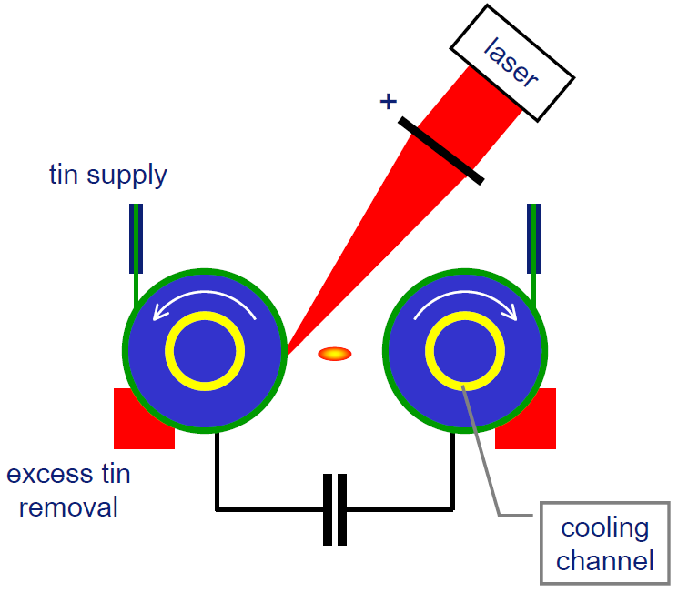
Philips
Discharged-produced plasma
Laser used as trigger (vaporizes and causes discharge)
Electrodes discharge leads to
capacitor discharge
Conformal tin surface and cooling challenges
Corthout et al., SPIE Advanced Lithography (2009)
Notes:
Philips developed discharge-produced plasma tool for EUV lithography
Principle is tin covered electrodes discharged by laser trigger
Trigger causes capacitor to discharge => plasma
Tin surface on electrodes heals by tin supply
Cooling by tin bath

Slide 14
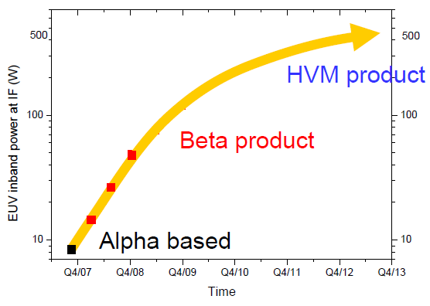
Philips (Continued)
Still only in developmental stage
Not capable of HVM yet
Corthout et al., SPIE Advanced Lithography (2009)
Notes:
Still in developmental process
No concrete data on progress towards HVM

Slide 15
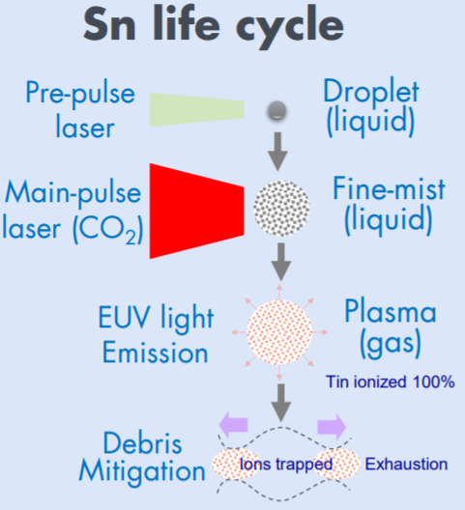
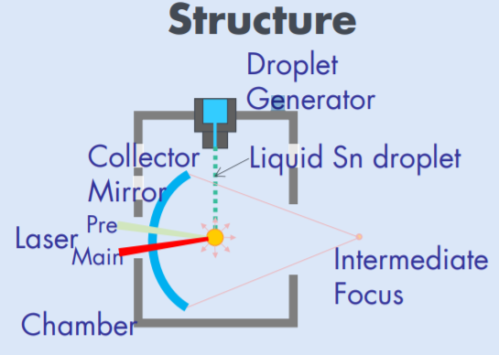
Gigaphoton
Laser-produced plasma
Sn droplet
Pre-pulse laser for size matching with main pulse laser => CE improved
H. Mizoguchi, 2017 EUV-FEL WS
Notes:
Gigaphoton employs laser-produced plasma tool
Tin droplets are exposed to laser pulses
Defining feature is in pre-pulse to excite droplets and create mists
Main pulse to create plasma

Slide 16
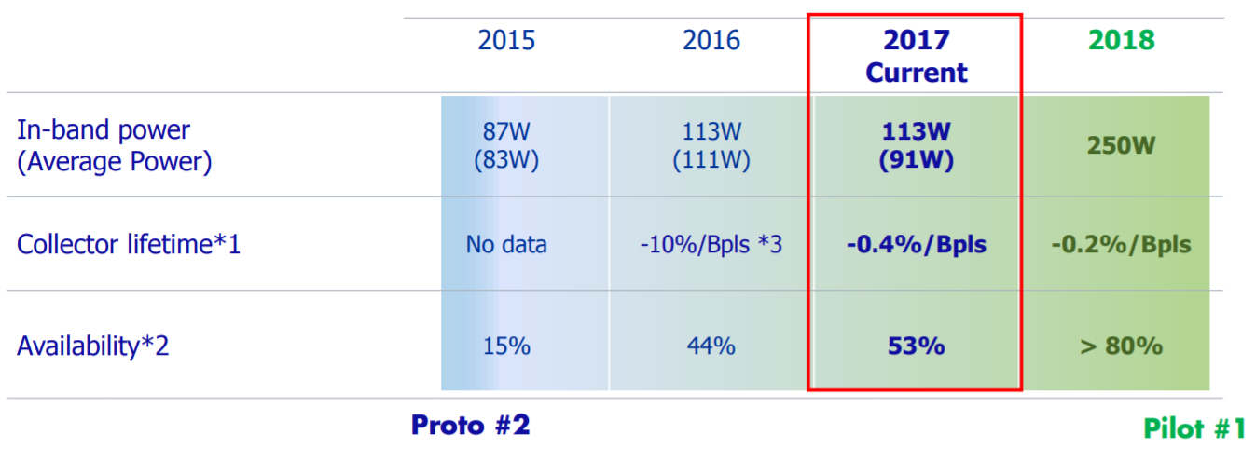
Gigaphoton (Continued)
Still prototype
*2 Availability in 4 weeks operation
H. Mizoguchi, 2017 EUV-FEL WS
Notes:
Very high power achieved but only in R&D stage
Optimistic for 2018 targets

Slide 17
Cymer
Similar principle to Gigaphoton (LPP)
Notes:
Similar principle to Gigaphoton’s EUV tool – uses multi-stage laser and beam transport and focusing system to enhance laser power
Multi-stage amplifies laser light

Slide 18
Cymer (Continued)
Still in development
Envision great boost in power for HVM
Notes:
Also optimism seen in roadmap
Currently in HVM I stage

Slide 19
Conclusion
EUV offers possible path towards smaller feature sizes – continuing Moore’s Law
Numerous technical challenges (throughput, masks and debris mitigation for collector lifetime)
Manufacturers have optimistic targets but still need to wait and see
Other options: imprint lithography, double patterning … should still be considered
Will Moore’s Law be kept alive? Given the high costs of R&D?

Slide 20
Thank you for your attention. Any questions?

